Slide 1
Counselling Session Booking
Applied Database Practicum Project
By Group G-10
(B21136, B21137, B21138, B21139, B21140, B21141)

Slide 2
CONTENTS
1
TOPIC OF CHOICE
4
WORK DESCRIPTION
2
ABOUT THE PROJECT
5
OVERVIEW
3
DETAILS ABOUT PROJECT
6
CONCLUSION

Slide 3
SYMPTOMS OF MENTAL ILLNESS INCLUDE:
Reason behind choice of the project
Physical symptoms include : drastic weight changes, chronic headaches, may lead to overeating or loss of appetite
Intense Emotions :
Constant feelings of overwhelming fear or worry
Behavioral and mood changes:
Drastic changes in behavior ilke acting up, fighting etc. Mood changes like feeling of sadness and withdrawal
Difficulty Concentrating :
Trouble focusing that leads to poor performance, hyperactivity.
Notes:
A person may seem distracted or uninterested in the activity presented to them.

Slide 4
ABOUT THE PROJECT
KEY FEATURES
KEY FEATURES
STEPS
STEPS
FOCUSED ON USER - FRIENDLY INTERFACE AND EASE OF ACCESS.
FOCUSED ON EASE OF ACCESS AND USER - FRIENDLY INTERFACE.
-REGISTRATION
-
- REGISTRATION
- LOGIN
- BOOK A SESSION
ABOUT
AIM
RELIABILITY
THIS PROJECT IS ABOUT CREATING AN ONLINE PLATFORM FOR COUNSELLING
“MENTAL HEALTH COUNSELLING ACCESSIBLE FOR ALL”
USER INFORMATION WILL BE SAFE AND CONFIDENTIAL.
Notes:
Mental illness does not discriminate, it could affect anyone, at any stage of life. Then, why should there be discrimination in availability of resources for counselling?

Slide 5
DETAILS ABOUT THE PROJECT
List of counsellors is visible with slots after logging in. One session per day per customer is permitted. Session available next day after booking.
Languages and frameworks used: Javascript, NodeJS, HTML, CSS, MongoDB
Editors and consoles used: VScode, Sublime Text, NodeJS terminal shell, Mongosh
Frontend using HTML, CSS, Bootstrap
Backend using NodeJS and MongoDB

Slide 6
Work Description
FRONTEND: For this we made templates for login, registration and home page form. These templates are designed using bootstrap, HTML ,CSS and javascript.
BACKEND: We used NodeJS (javascript framework used for server-side programming) as a backend. For database management we used Mongodb.
Then we connect mongodb to the NodeJS for creating database.
After this we install some NodeJS dependencies which are helpful for our project.
We made a javascript file in which we wrote the whole backend code.
Inside backend we connected our website to host and port. We took information from the registration form in a collection of our database using backend. Sessions for booking is also sent on frontend using nodejs.
For rendering different pages we use backend.
Notes:
First we prepare frontend for our project

Slide 7

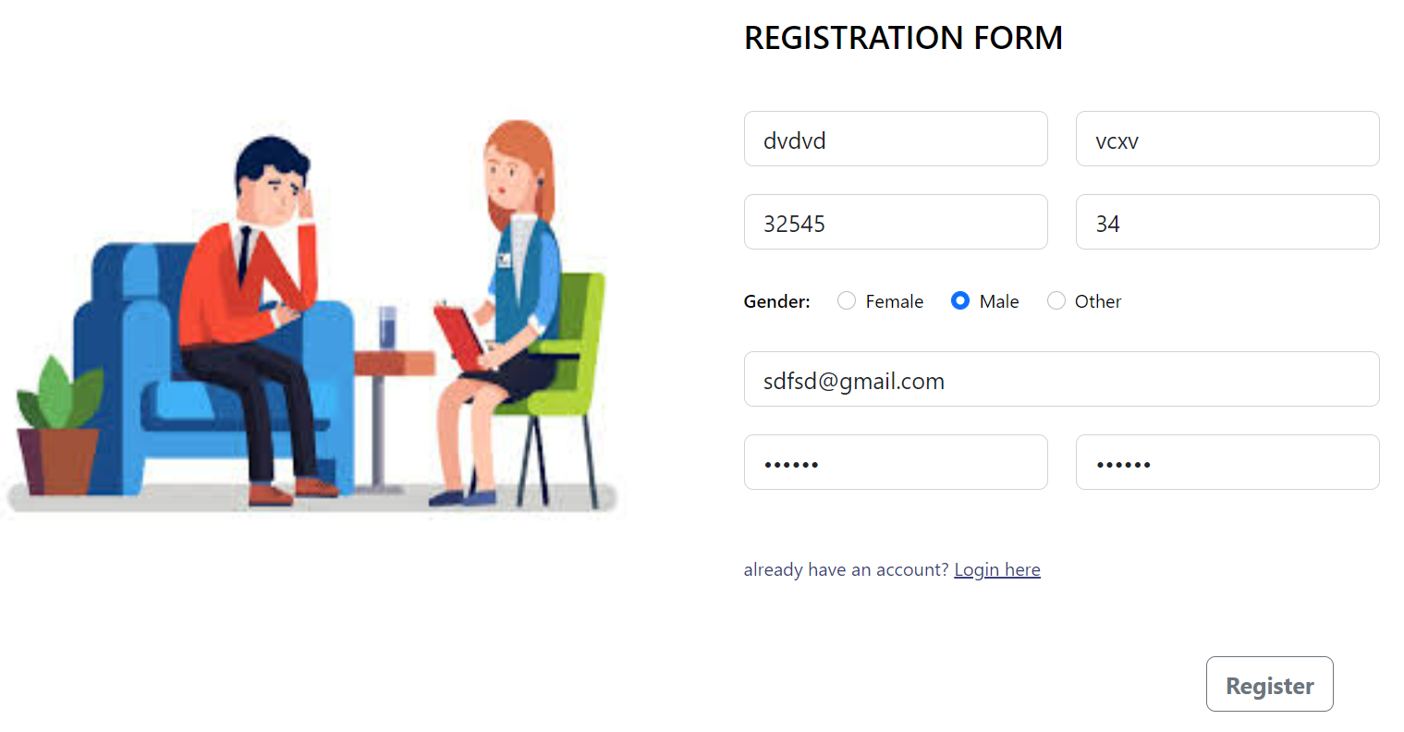
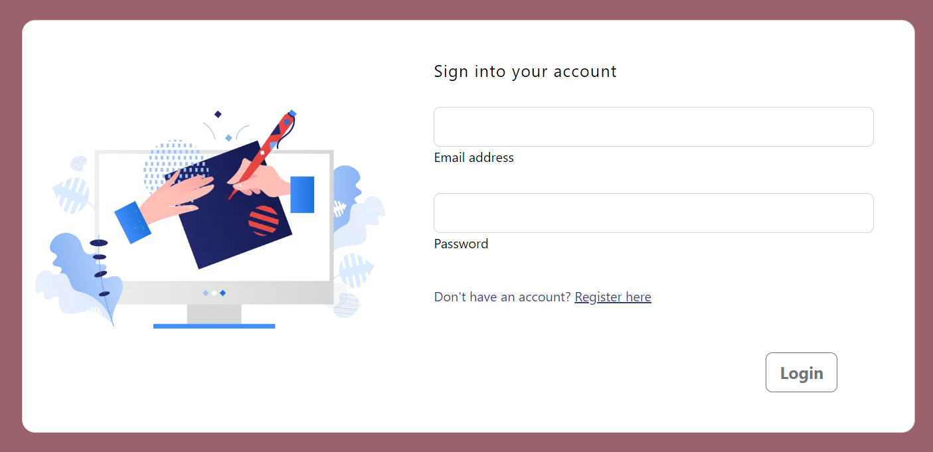
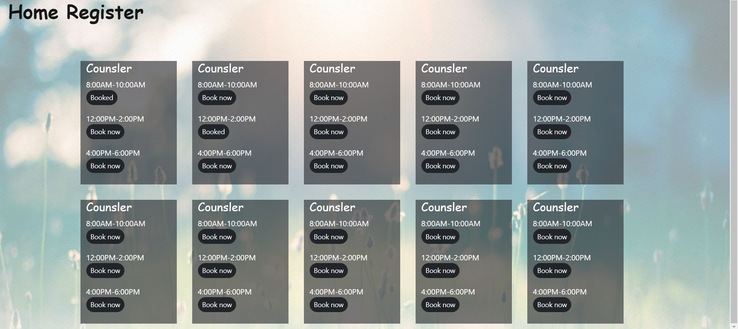
Overview to the final result

Slide 8
Conclusion
Making a database system with an interactive interface is challenging for new learners. While working on this project we faced many challenges and obstacles but we learnt the valuable lesson of teamwork and successfully created a functional website with connected database. The course of CS 207 helped a lot in this regard . It’s easy to lose track of progress in a big project but we kept documenting our progress. Here we managed to work effectively and efficiently and helped our teammates out in time of need. That’s how we moulded the counselling session booking system to the final version.
We would like to thank Varun Dutt sir, Aadhar Gupta sir, our project mentor Hemant and various other TA’s who helped us throughout this course and helped us understand various frameworks and tools effectively. We hope our work can compete with the best of session booking systems out there if not more efficiently.

Slide 9
Mercury is the closest planet to the Sun and the smallest
THANK YOU !
ANY QUESTIONS ?
Saturn is composed mostly of hydrogen and helium

